Slide 1
Using Hardware Features for Increased Debugging Transparency
Instructor: Kun Sun, Ph.D.
College of William and Mary

Slide 2
Overview
Background
Motivation
Background: System Management Mode (SMM)
System Architecture
Evaluation
Conclusion
Future Work

Slide 3
Overview
Background
Motivation
Background: System Management Mode (SMM)
System Architecture
Evaluation
Conclusion
Future Work

Slide 4
Isolated Computing Environment (ICE)
Software-based ICE
Virtual Machine: KVM, Xen, VMware
OS container: LXC, OpenVZ
App sandbox: browser applet
Hardware-based ICE
x86: SMM, TXT/SVM, SGX, GPU
ARM: TrustZone
Trusted Elements: USB token, SIM card

Slide 5
Why ICE?
Code Protection
Software-based ICE
Protecting the sensitive code running in one ICE from other ICEs, but not from the underlying high-privileged software
Constraining the potential malicious code in one ICE from compromising other ICEs and the underlying high-privileged software
Hardware-based ICE
protecting the sensitive code running in the ICE from all the other software running on the system

Slide 6
Why ICE?
Code Introspection
Software-based ICE
Checking the code in the ICE from the underlying high-privileged software
e.g., VMI, hypervisor checking the integrity of the kernel code and critical structures in VMs.
Hardware-based ICE
Checking the integrity of the host OS from the ICE, only if supported by the hardware design and the code in the ICE can be changed.
Yes: SMM, TrustZone
No: Sim card, Square
?: SGX, USB token

Slide 7
Overview
Background
Motivation
Background: System Management Mode (SMM)
System Architecture
Evaluation
Conclusion
Future Work

Slide 8
Motivation
Malware attacks statistics
Symantec blocked an average of 247,000 attacks per day [1]
McAfee (Intel Security) reported 8,000,000 new malware samples in the first quarter in 2014 [2]
Kaspersky reported malware threats have grown 34% with over 200,000 new threats per day last year [3]
Computer systems have vulnerable applications that could be exploited by attackers.

Slide 9
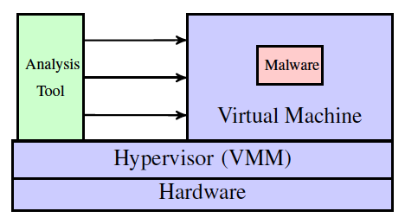
Traditional Malware Analysis
Using virtualization technology to create an isolated execution environment for malware debugging
Running malware inside a VM
Running analysis tools outside a VM

Slide 10
Limitations
Depending on hypervisors that have a large TCB (e.g., Xen has 500K SLOC and 245 vulnerabilities in NVD)
Incapable of analyzing rootkits with the same or higher privilege level (e.g., hypervisor and firmware rootkits)
Unable to analyze armored malware with anti-virtualization or anti-emulation techniques
Suffering from high overhead on system performance

Slide 11
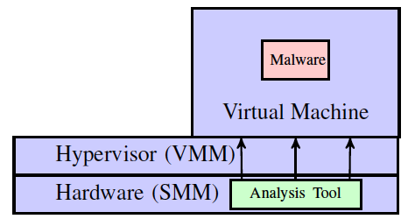
Our Approach
We present a bare-metal debugging system called MalT that leverages System Management Mode for malware analysis
Uses SMM as a hardware isolated execution environment to run analysis tools and can debug hypervisors
Moves analysis tools from hypervisor-layer to hardware-layer that achieves a high level of transparency

Slide 12
Overview
Background
Motivation
Background: System Management Mode (SMM)
System Architecture
Evaluation
Conclusion
Future Work

Slide 13
System Management Mode
System Management Mode (SMM) is special CPU mode existing in x86 architecture, and it can be used as a hardware isolated execution environment.
Originally designed for implementing system functions (e.g., power management)
Isolated System Management RAM (SMRAM) that is inaccessible from OS
Can access the system resource of OS
Only way to enter SMM is to trigger a System Management Interrupt (SMI)
Executing RSM instruction to resume OS (Protected Mode)

Slide 14
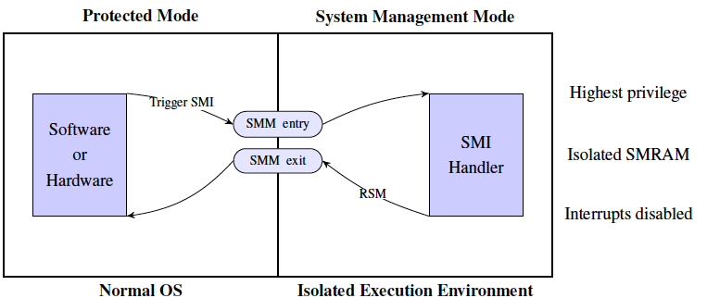
SMM
Approaches for Triggering a System Management Interrupt (SMI)
Software-based: Write to an I/O port specified by Southbridge datasheet (e.g., 0x2B for Intel)
Hardware-based: Network card, keyboard, hardware timers

Slide 15
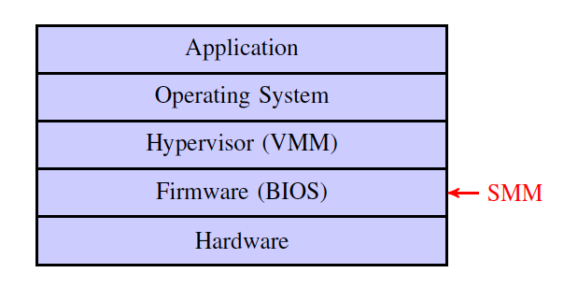
Software Layer

Slide 16
Overview
Background
Motivation
Background: System Management Mode (SMM)
System Architecture
Evaluation
Conclusion
Future Work

Slide 17
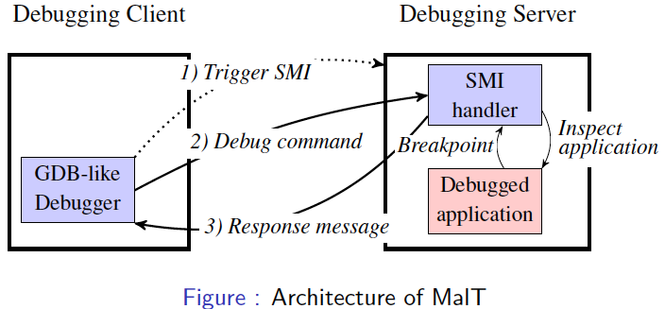
System Architecture
Traditionally malware debugging uses virtualization or emulation
MalT debugs malware on a bare-metal machine, and remains transparent in the presence of existing anti-debugging, anti-VM, and anti-emulation techniques.

Slide 18
Basic Debug Commands
R: read all registers
Wr1r2…rn: write to certain register
mAAAALLLL: read from particular memory address
sAAAALLLL: write to particular memory address
BAAAA: set a new breakpoint
KAAAA: remove a breakpoint
X: clear all breakpoints
C: continue execution after a breakpoint
SI, SB, SF, SN: stepping command
Debugging memory needs to fill the semantic gaps, since all the addresses are virtual addresses.

Slide 19
Breakpoints in MalT
Software-based breakpoints are not stealthy.
We use hardware-based breakpoints
For each Protected Mode instruction, the SMI handler takes the following steps:
Check if the target application is the running thread when the SMI is triggered
Check if the current EIP equals to a stored breakpoint address
Start to count instructions in the performance counter, and set the corresponding performance counter to the maximum value
Configure LAPIC so that the performance counter overflow generates an SMI.

Slide 20
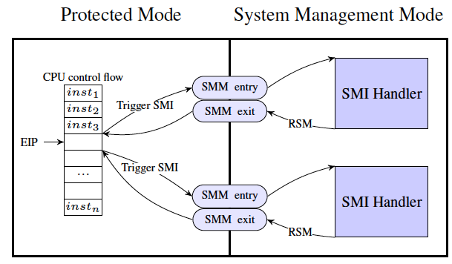
Step-by-step Debugging in MalT
Debugging program instruction-by-instruction
Using performance counters to trigger an SMI for each instruction

Slide 21
Performance Counter Events
Retired instructions: Counts retired instructions, plus exceptions and interrupts (each count as one instruction)
Retired taken branches: Includes all types of architectural control flow changes, including exceptions and interrupts
Retired far control transfers: Includes far calls/jumps/returns, IRET, SYSCALL and SYSRET, exceptions and interrupts
Retired near returns: Counts near return instructions (RET or RET Iw) retired

Slide 22
Overview
Background
Motivation
Background: System Management Mode (SMM)
System Architecture
Evaluation
Conclusion
Future Work

Slide 23
Transparency Analysis
Two subjects: 1) running environment and 2) debugger itself
Running environments of a debugger
SMM vs. virtualization/emulation
Side effects introduced by a debugger itself
CPU, cache, memory, I/O, BIOS, and timing

Slide 24
Towards True Transparency
MalT is not fully transparent (e.g., external timing attack) but increased
Draw attention to hardware-based approach for addressing debugging transparency

Slide 25
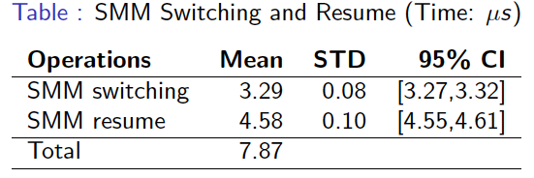
Performance Analysis
Testbed Specification
Motherboard: ASUS M2V-MX SE
CPU: 2.2 GHz AMD LE-1250
Chipsets: AMD K8 Northbridge + VIA VT8237r Southbridge
BIOS: Coreboot + SeaBIOS

Slide 26
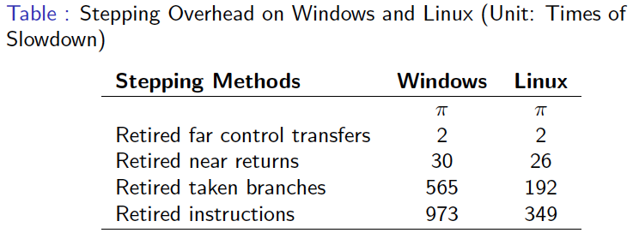
Performance Analysis

Slide 27
Overview
Background
Motivation
Background: System Management Mode (SMM)
System Architecture
Evaluation
Conclusion
Future Work

Slide 28
Conclusion
We developed MalT, a bare-matal debugging system that employs SMM to analyze malware
Hardware-assisted system; does not use virtualization or emulation technology
Providing a more transparent execution environment
Though testing existing anti-debugging, anti-VM, and anti-emulation techniques, MalT remains transparent

Slide 29
Future Work
Limitations of SMM
Not designed for security purpose
May contain unknown vulnerability, such as SMM-based rootkits
Other hardware-based solutions
TrustZone-based solution
Stealthy debugging
Side channel attacks
SGX-based solution
Side channel attacks
SGX emulator will be available soon.

Slide 30
Thank you!
Questions?

